Slide 1
Raspberry pi based weather Reporting over IOT
Under guidance of
Mr. GopalKrishnan,
Asst.Prof IT,
BIT,
Sathy.
202IT107 – AKASH S
202IT183 – NITYASREE G C
202IT197 – RAGAVI R
202IT196 – RAAHUL P S

Slide 2
Abstract
Our team has given the brief explaination about this project in ppt. Our output of this project idea can be used to monitor and update weather conditions over the internet. This system monitors 3 parameters namely temperature, humidity and rainfall these values are then displayed on LCD and also updated over the IoT gecko. By readings, the user can get a fair idea of the weather of a particular area on the monitor. This system proves to be useful for knowing the weather of the localized area. The system is powered by Raspberry Pi it includes a raindrop sensor, a temperature sensor, LCD and a buzzer. After turning the system on, the system gets connected to the website by using WIFI. The system keeps track of 3 parameters like temperature, humidity, and rain. As the weather changes the system to monitor and updates the status over the IOT when the area is dry it shows zero value. When the system detects raindrop, it shows the value of the increase in rainfall. When the temperature increases the value gets updated. The user can observe the weather status of a particular area from any remote location.

Slide 3
Problem Statement Addressed
* Our aim is to predict the weather condition of particular area with the usage of temperature, humidity and rainfall parameters

Slide 4
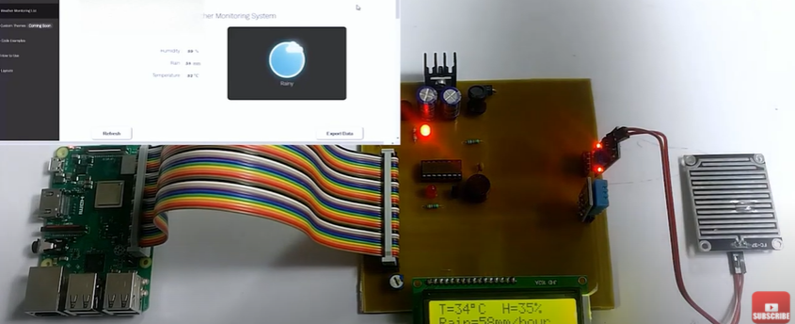
Existing Solution to the Problem Addressed
our final output will be displayed on the system with the usage of hardware components.

Slide 5
Proposed Solution to the Problem Addressed
This system monitors 3 parameters namely temperature, humidity and rainfall these values are then displayed on LCD and also updated over the IoT gecko.
By readings, the user can get a fair idea of the weather of a particular area on the monitor.
This system proves to be useful for knowing the weather of the localized area. The system is powered by Raspberry Pi it includes a raindrop sensor, a temperature sensor, LCD and a buzzer.
After turning the system on, the system gets connected to the website by using WIFI.
The system keeps track of 3 parameters like temperature, humidity, and rain.

Slide 6
As the weather changes the system to monitor and updates the status over the IOT when the area is dry it shows zero value.
When the system detects raindrop, it shows the value of the increase in rainfall.
When the temperature increases the value gets updated. The user can observe the weather status of a particular area from any remote location.

Slide 7
Project Work Plan
First collect the hardware components with each specification that needed for our project.
Integrate the each components together to get final output.
By working with this the output will be displayed on the monitor.

Slide 8
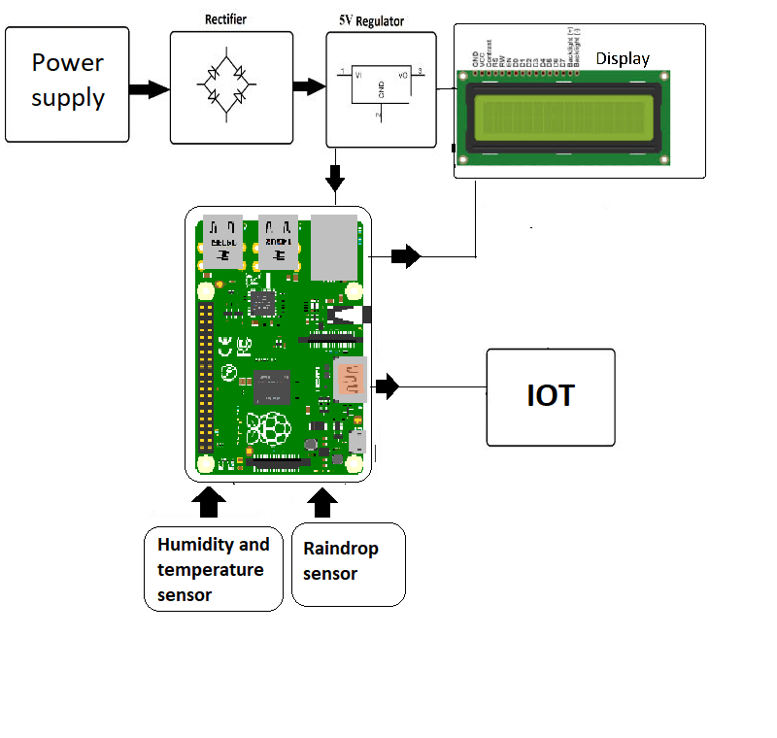
Block Diagram and/or Circuit Diagram

Slide 9
Flow Chart
5V Regulator
Display
Power supply
Rectifier
Motherboard

Slide 10
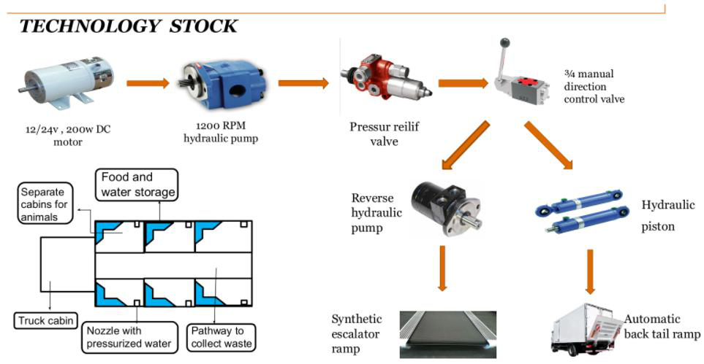
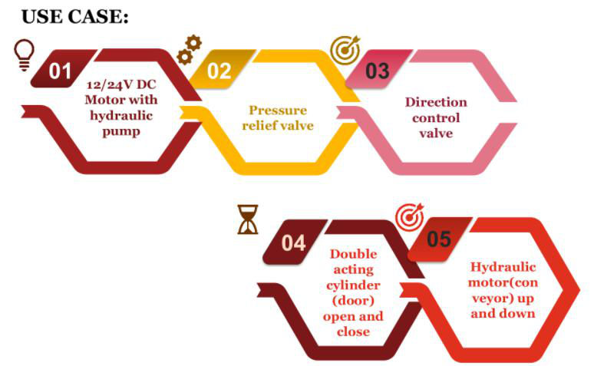
Technology stack & use case

Slide 11
Prototype & Sample Output

Slide 12
Analysis of Results & Discussions
Advantages:
By using this system user can easily predict the weather condition from their place
DisAdvantages:
From this device for the same temperature and humidity it may not able predict the correct output
Conclusion:
This system is very usefull for every users.

Slide 13
Cost Benefit Analysis (List of Components / Service Used)
(Budget)
S.No | Component Name | Specification (IC number or Range or Value) | Unit Cost | Total Cost
1 | Raspberry pi 3 model B RAC Motherboard | 12.28x7.6x3.4cm | 3400 | 3400
2. | DHT11 Digital Temperature Humidity sensor module arudino compatibility | 40 x 20 x 10 Millimeters | 160 | 160
3. | Raindrop sensor | 3.2cm x 1.4cm | 130 | 130
4. | 16 x 2 LCD display | 16 Characters x 2 Lines | 130 | 130

Slide 14
Working video Link (If available)
https://www.youtube.com/watch?v=Trwrl9aPmno&t=9s

Slide 15
References
https://nevonprojects.com/raspberry-pi-based-weather-reporting-over-iot/
http://synopsis.nevemtech.com/index.aspx?Id=N420
https://youtu.be/Trwrl9aPmno

